Slide 1


Mushrooms
Tim Smith
Kristen Hanold
Shermeen Ajani

Slide 2
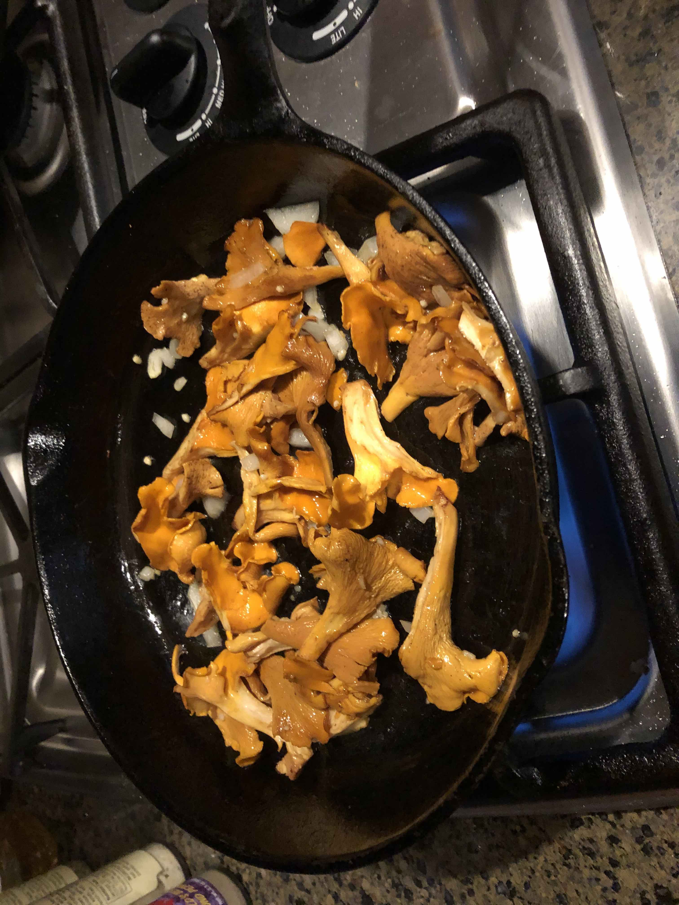

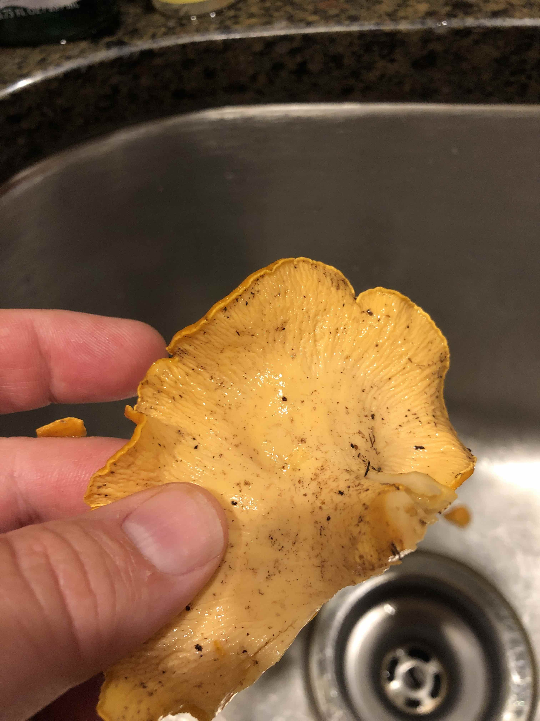
Why Mushrooms?
One of our group members enjoys trying new things – even mushrooms from their backyard without knowing if it’s poisonous or not!!!

Slide 3

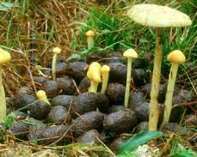
Data Set
We selected our data set from the University of California Irvine
https://archive.ics.uci.edu/ml/datasets/Mushroom
Total # of Records: 8,124
# Poisonous: 4,208 (52%)
# Edible: 3,916 (48%)

Slide 4

The Analysis Process - Tableau
Create visualizations based on characteristics for poisonous mushrooms
Utilize the ReadMe provided with the data set from UCI to determine key characteristics grouped together to identify poisonous mushrooms

Slide 5
The Story Using Tableau
The Mushroom Story on Tableau Public

Slide 6
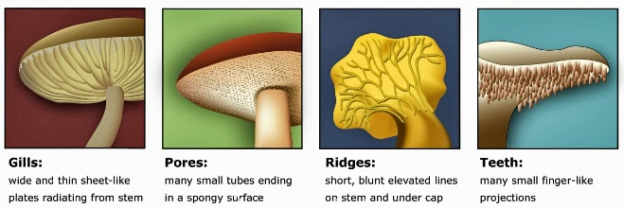
The Analysis Process – Deep Learning
Training a Neural Network Model using all 22 characteristics in the data set
Training a Neural Network Model using a subset of characteristics based on prior knowledge, experience and educated guess
Training a Neural Network Model using the 6 key characteristics identified in the agaricus-lepiota README included with the dataset from UCI and using automated hyperparameter testing

Slide 7
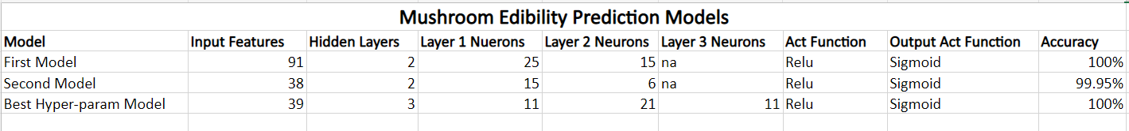
Summary of Neural Network Features

Slide 8
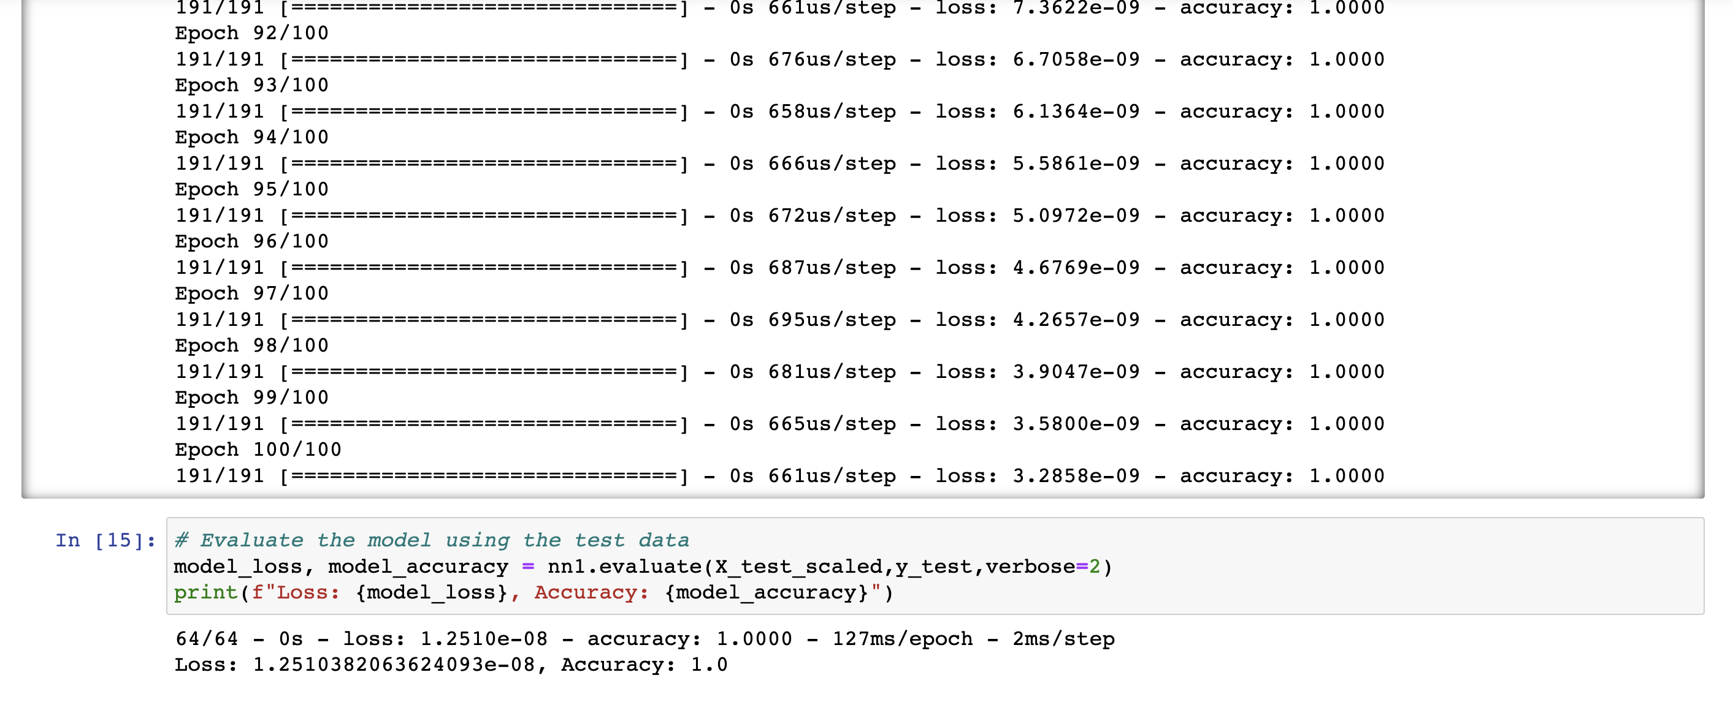
Training a Neural Network Model using all 22 characteristics in the data set

Slide 9
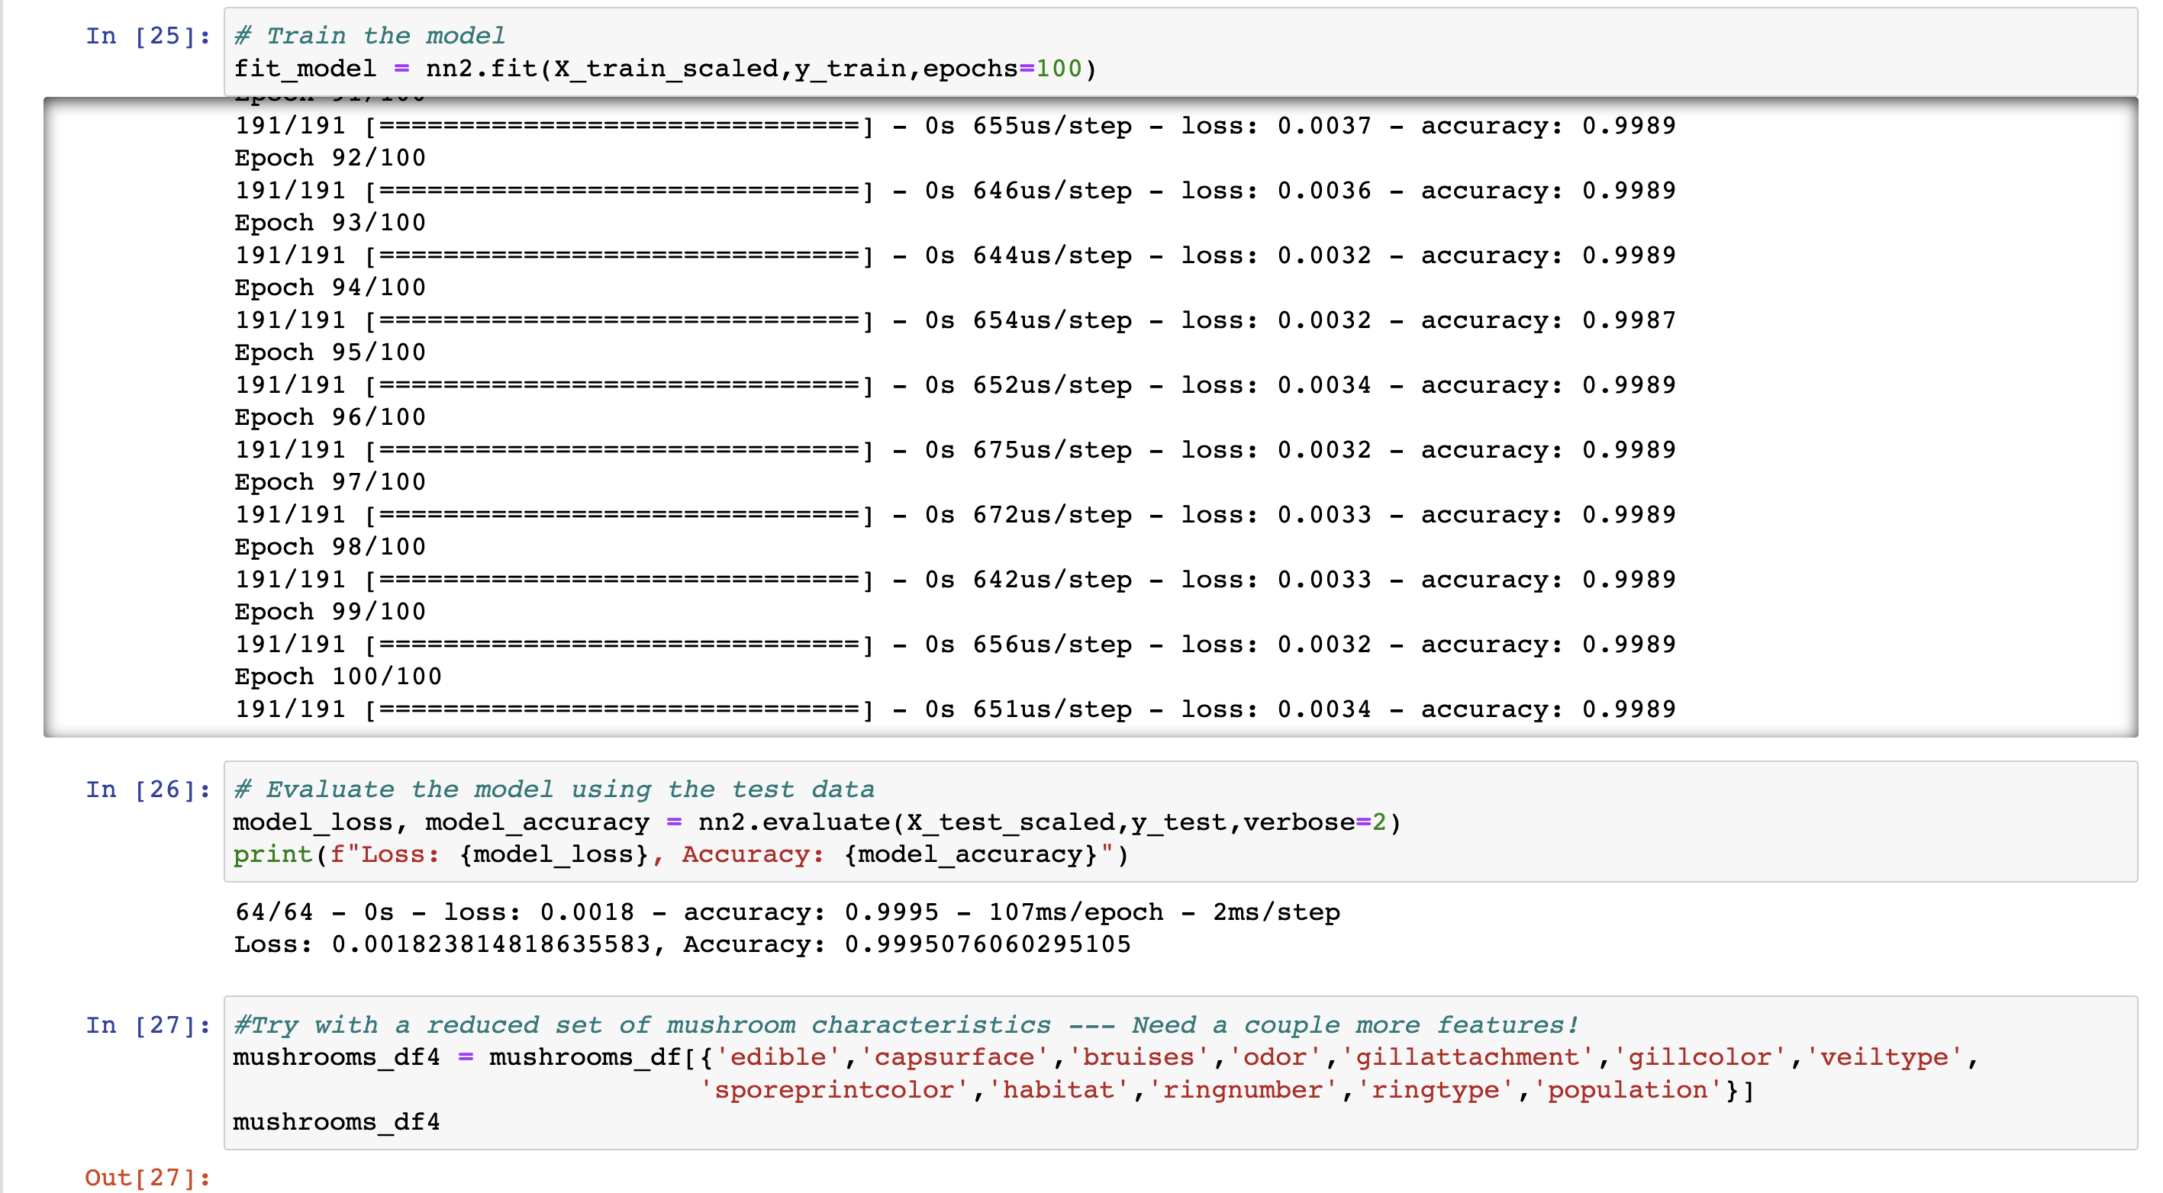
Training a Neural Network Model using a subset of Characteristics

Slide 10
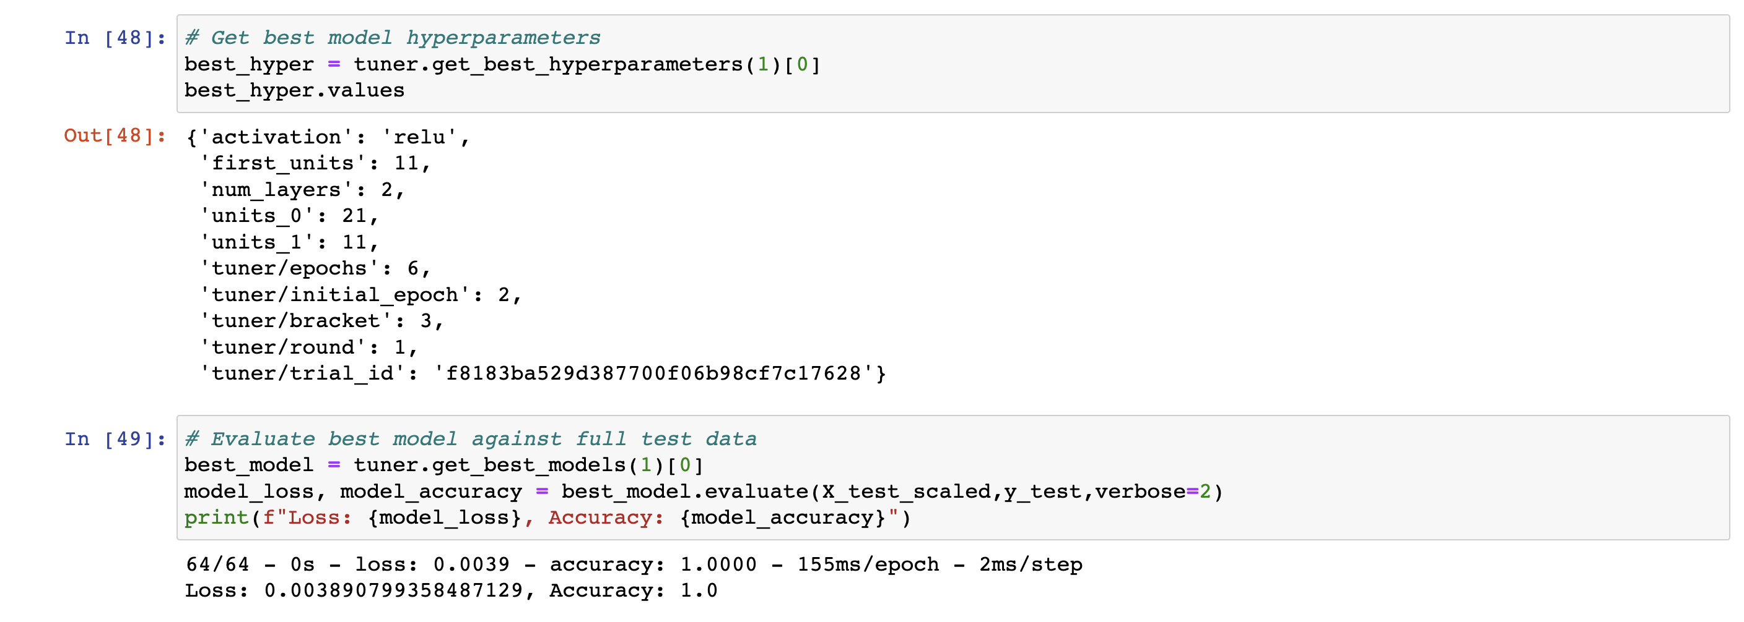
Training a Neural Network Model using the 6 key Characteristics

Slide 11
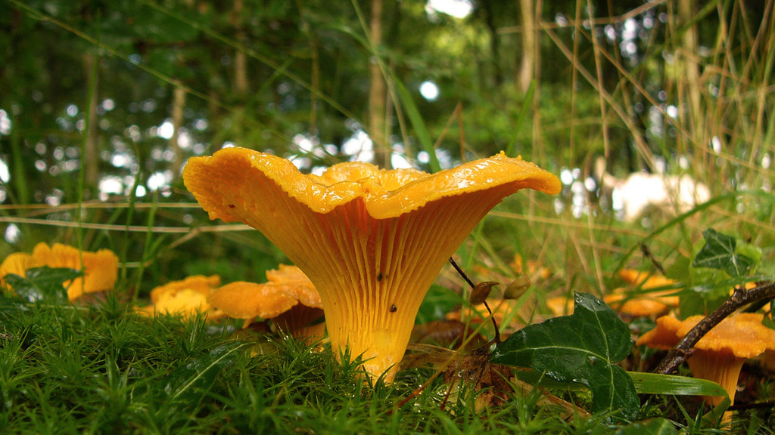
Our Findings
The six characteristics are sufficient for identifying a mushroom as edible or poisonous:
Odor
Spore Print Color
Habitat
Population
Cap Color
Stalk Surface Below Ring

